Slide 1


Slide 2


VSCode
Let’s discuss how to use VSCode exclusively in lieu of PDSOE and what I’ve learned so far. This will include leveraging Docker containers for OE, and the different environments our engineers choose to use (local repos, WSL, Dev Containers).
Presented By: Ken Herring, 2023-09-20
GitHub: @kenherring - https://github.com/kenherring
LinkedIn: https://www.linkedin.com/in/ken-herring-b55b5287/
Email: kennethherring@gmail.com

Slide 3


About Me
I currently live in Tampa, FL
Originally from Bethlehem, PA
I’ve been writing code my whole life, professionally since 2010
First used OpenEdge in 2010
Started my career in ERP @ Apprise Software
Currently work for Rocket Mortgage as a Staff Software Engineer
I have two dogs: Maia and Lily

Slide 4

Agenda
What is VSCode? Why should we use it?
A little info about Docker
GitHub CoPilot
Live Demo

Slide 5
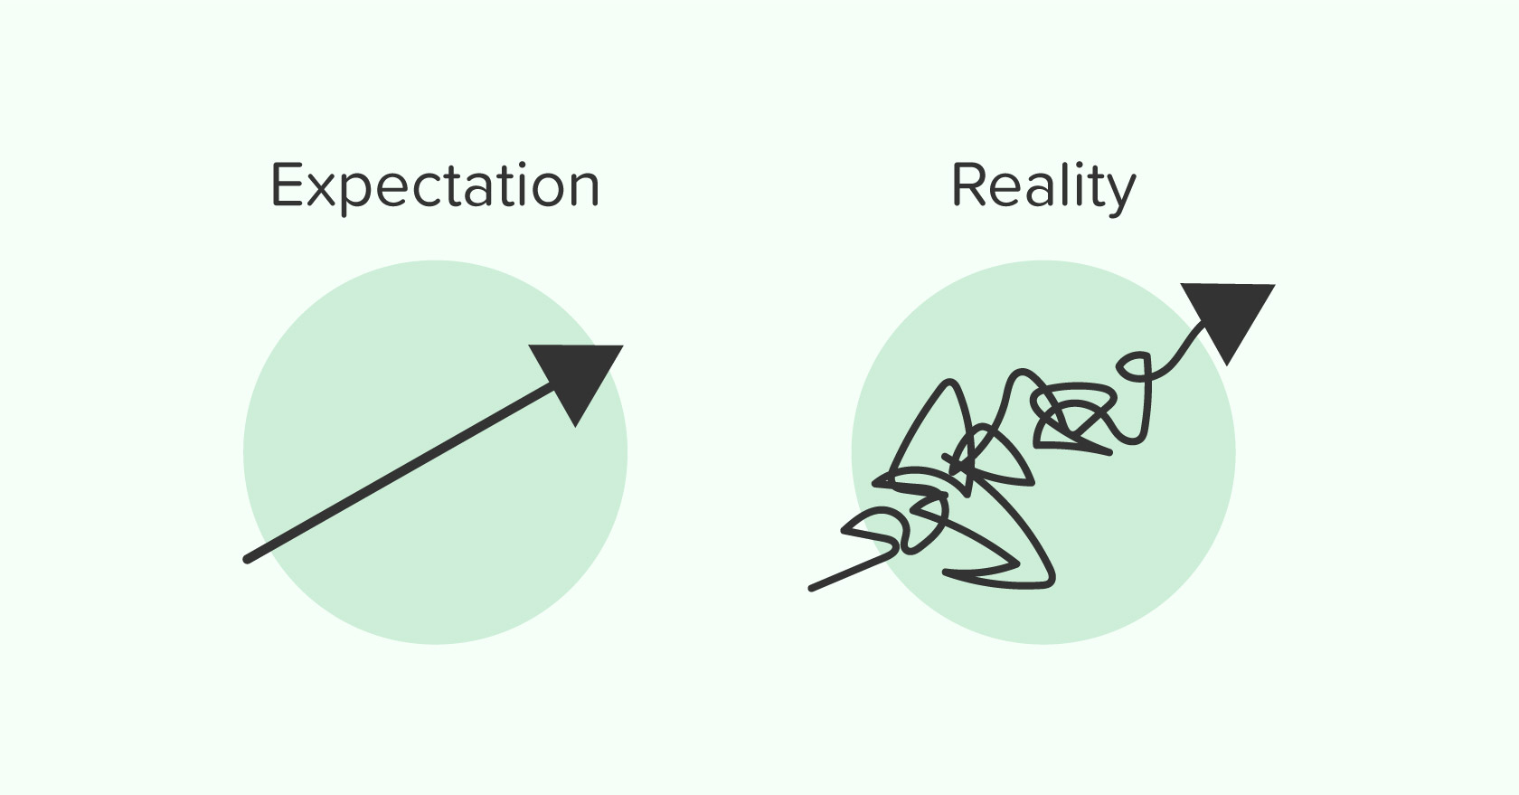
Session Expectations
Target Audience: anyone who writes code
Takeaways:
Existing Users
I hope you’ll have some new skills to leverage
New Users
I hope you’ll decide to install VSCode and give it a chance

Slide 6
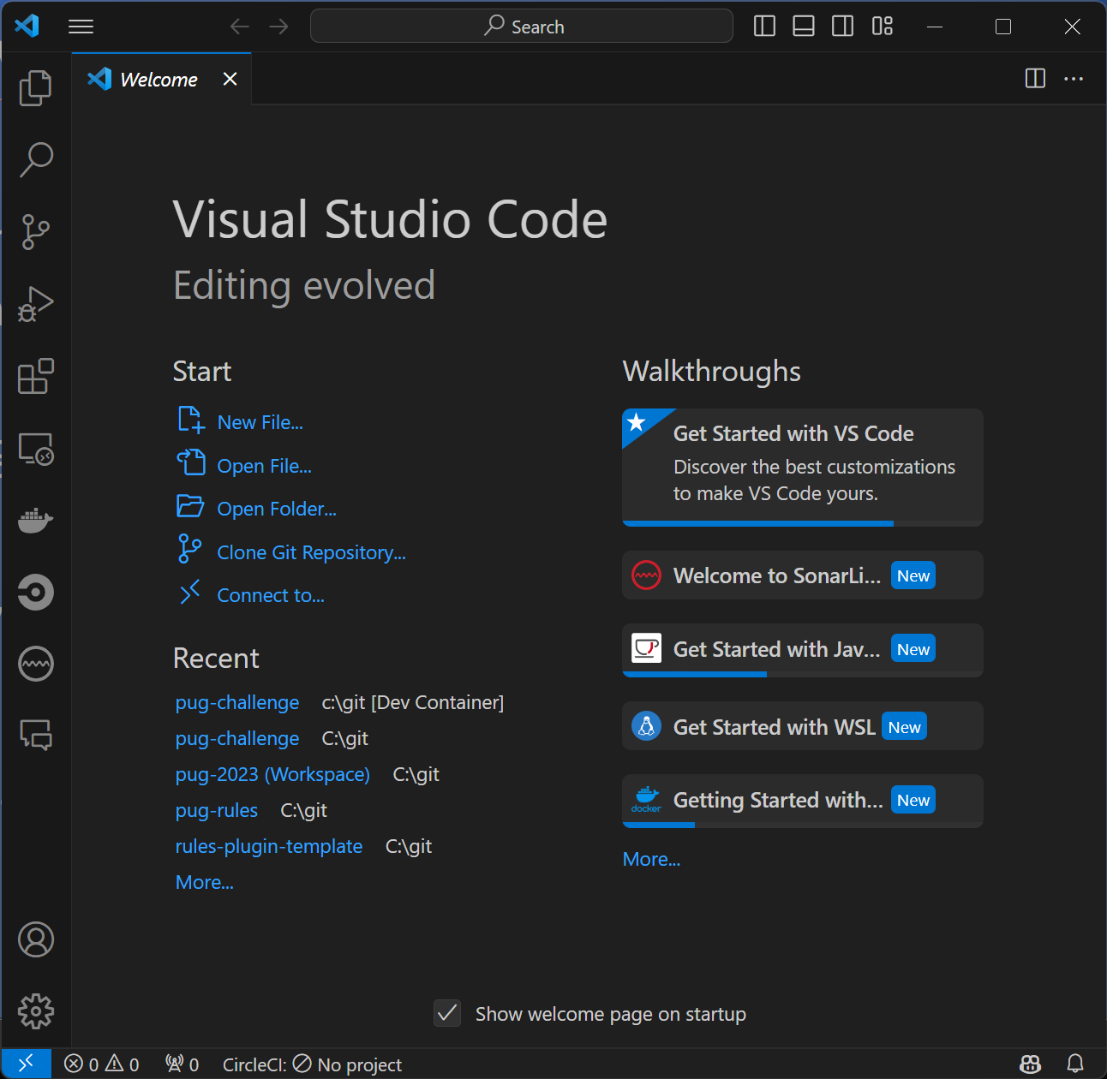
What is VSCode?
Code editing. Redefined.
Next-gen IDE
Language agnostic
Extensible via plugins
Highly configurable

Slide 7

Why use VSCode?
“Modernization” is the talk of the town
Skills translate to other languages
Regular updates w/ new features
GitHub CoPilot

Slide 8

Limitations of VSCode
Cannot use custom SonarQube rules… for now
CABL rules work
Some PDSOE features may be missing

Slide 9
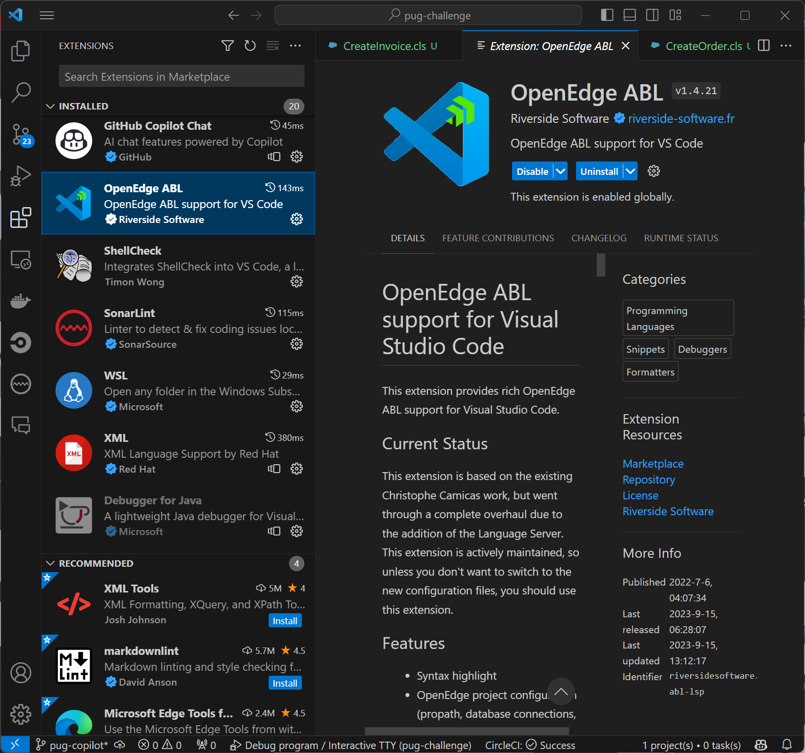
VSCode Features
Plugins
OpenEdge ABL
CircleCI, SonarLint, and so on…
CoPilot
Source Control Integration
Git specifically, but others too…
Code Snippets
Refactoring made easy
Tasks
Debugger
… and more!

Slide 10
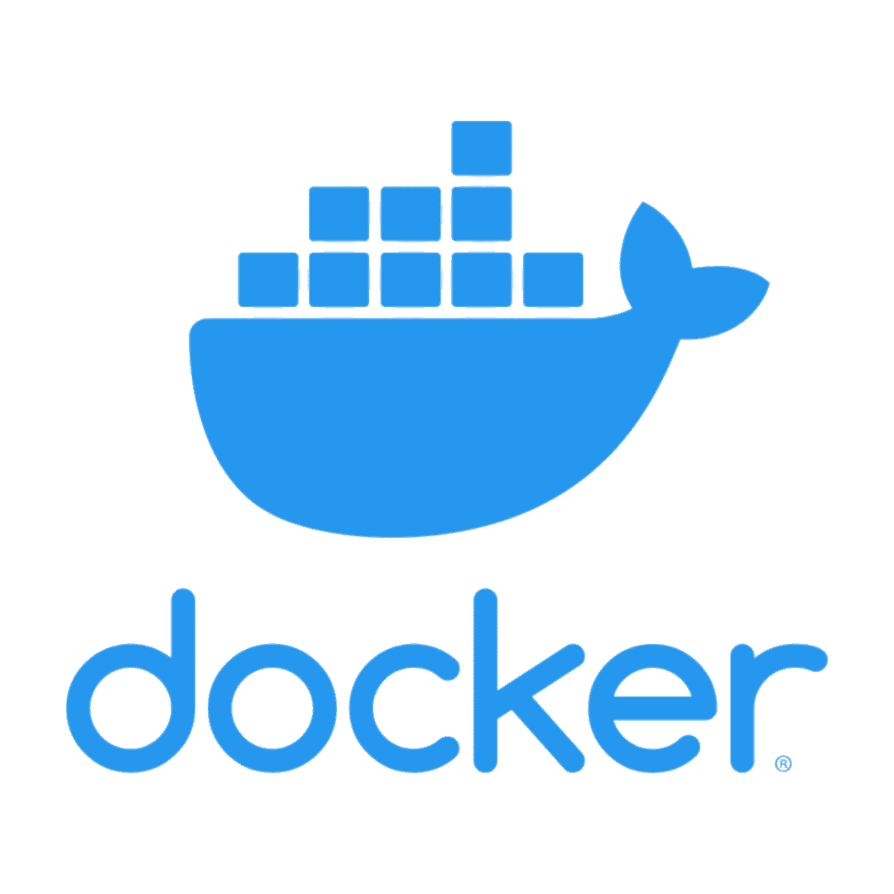
Docker & VSCode
Docker containerizes applications to improve portability and remove dependency issues
Many applications to development
Even easier with VSCode
Consistent environments/DBs
DevContainers

Slide 11
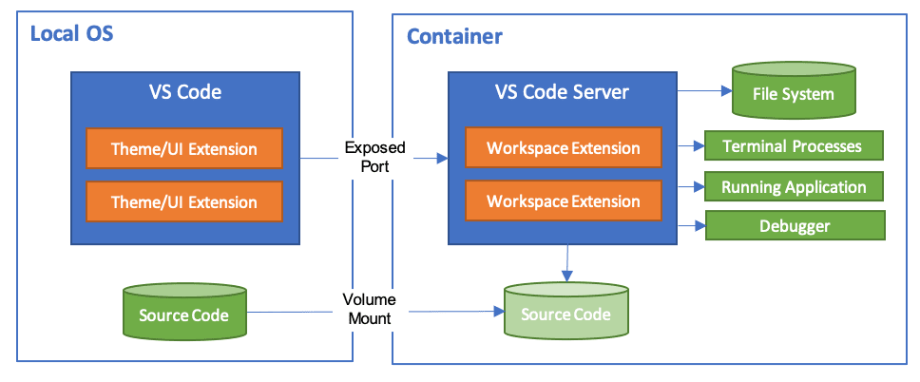
DevContainer? What the heck is that?
DevContainers are a concept where a development environment is fully available within a Docker container
GitHub Codespaces basically leverages this
Benefits:
Team consistency
No local install required
Quick ramp-up

Slide 12

GitHub CoPilot
VSCode Plugin
AI that helps write code
Does a decent job with OE code
Similar to intellisense, but better
Reduce repetitive tasks

Slide 13
Live Demo (plus Q&A)

Slide 14

Summary
VSCode is an IDE for the future
Plugins make engineering easy
Simultaneous cross-language development
Docker can provide additional consistency

Slide 15
Thank You!
Questions?

